Slide 1

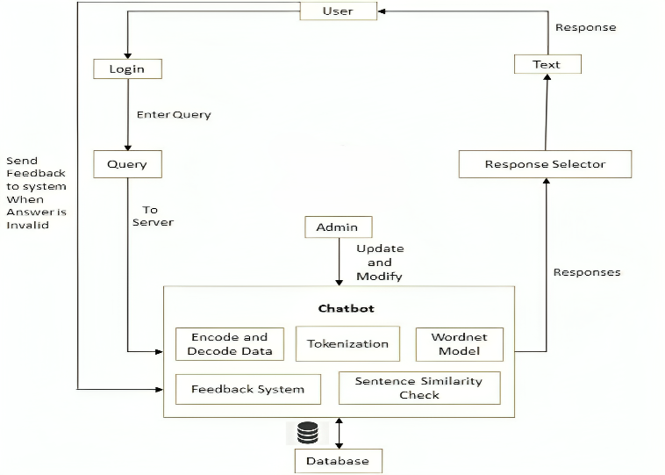
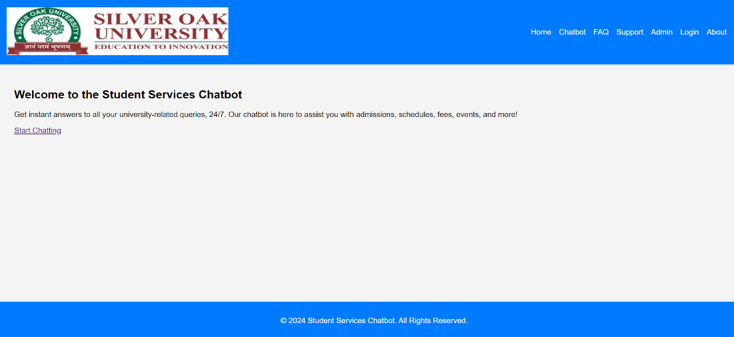
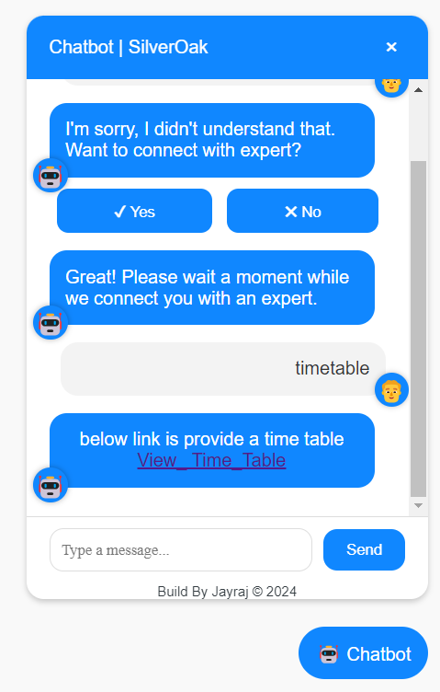
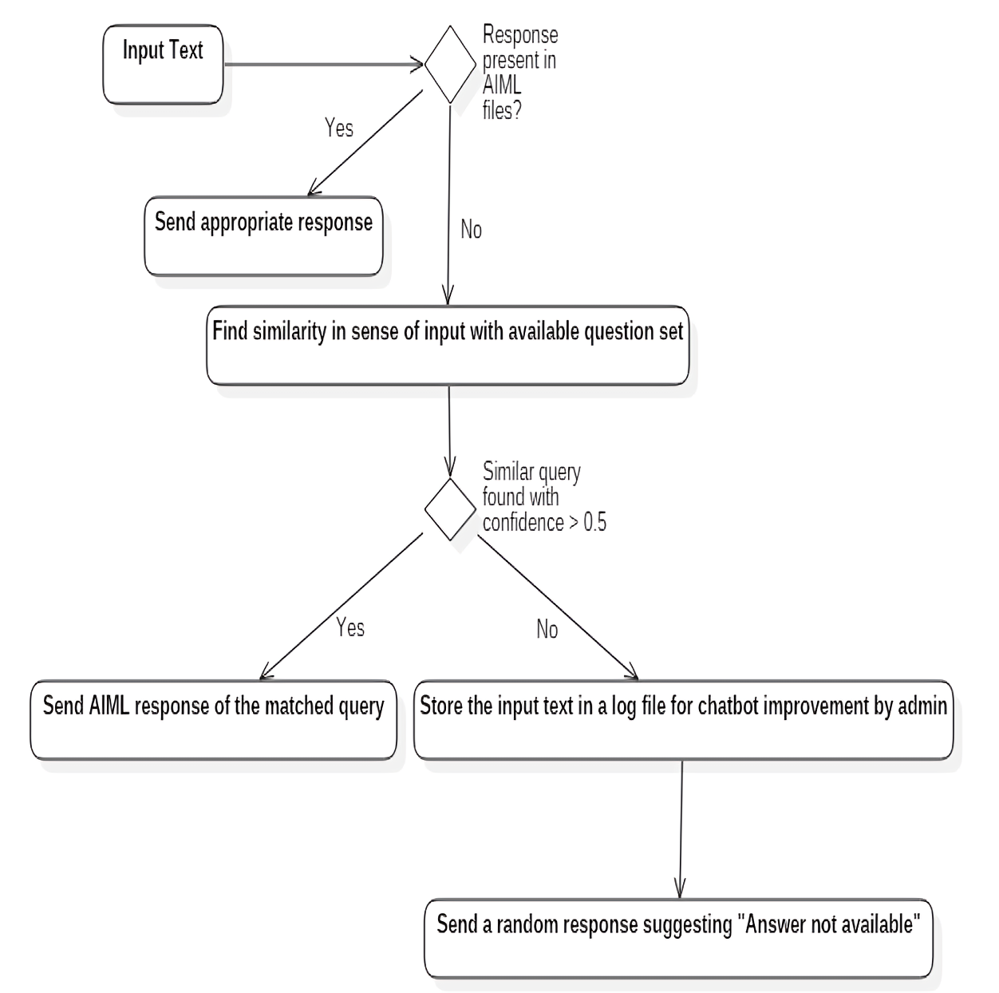
Student Services Chatbot System
COT-P1
1. Kalsariya Jayraj H. 2. Gadher Chirag N. 3. Chovatiya Harshil S. 4. Gadariya Bhupendrasingh S. Guided by Prof. Vishwas Sharma Silver Oak College Of Engineering and Technology, College of Technology, SOU
INTRODUCTION
SYSTEM FLOW with Experiments and Results
The Student Services Chatbot is designed to provide real-time responses to university-related queries, such as admissions, course schedules, fees, and campus events. By utilizing Natural Language Processing (NLP), this chatbot automates repetitive inquiries, improving overall efficiency and user experience.
GOALS & OBJECTIVES
Automate student interactions with 24/7 assistance.
Integrate with the university database to provide up-to-date information on admissions, schedules, and events.
Reduce administrative workload.
TECHNIQUES USED
Fig 2 : College Chatbot system architecture
Google Dialogflow or Microsoft Bot Framework: For development and integration with websites.
IMPLEMENTATION
User Interface (UI) Development ❖ Database Integration
Natural Language Processing (NLP) ❖ Deployment
ALGORITHM USED
Input Collection ❖ Intent Recognition
Text Preprocessing ❖ Query Classification
Database Query ❖ Response Generation Output
Block Diagram / Circuit diagram/ Drawings
Fig 1 : Activity Diagram of College Related Query Response
FUTURE SCOPE
❖ 24/7 Real-Time Assistance ❖ Enhanced Security and Privacy
❖ Mobile Application Integration ❖ Voice Interaction
❖ Advanced Natural Language ❖ Processing Scalability
CONCLUSION
The Student Services Chatbot will improve the overall efficiency of university services by providing instant, accurate responses and reducing administrative overhead.
REFERENCES
[1] MDPI. “EduChat: An AI-Based Chatbot for University-Related Information”, MDPI Journals, Vol. 5, pp. 45-60, April 2023.
[2] SpringerLink. “Design and Development of an Advising Chatbot for Student Support”, SpringerLink, Vol. 7, pp. 85-95, August 2023.
[3] Mawani, N., Basnet, R., Alotaibi, A., & Khalid, S. A. “Chatbot-based higher education quality enhancement”, Journal of Cases on Information Technology, Vol. 22(1), pp. 29-39, January 2020.

